Slide 1
Abdominal pain

Slide 2
Abdominal pain
Abdominal pain is a very common complaint in child hood . may be acute or recurrent
I- Surgical
Appendicitis
Pancreatitis
Intestinal obstruction
Intussusception
Urolithiasis
peritonitis

Slide 3
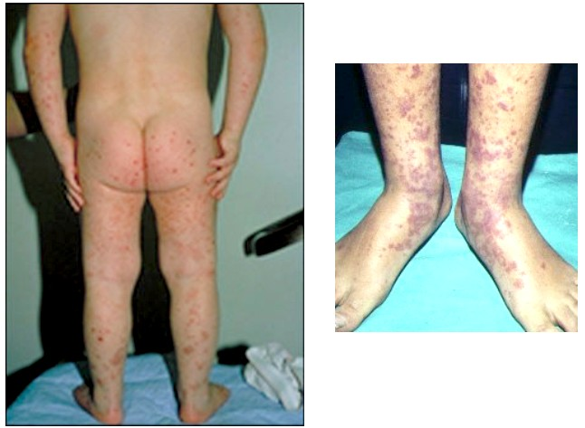
II-Medical CAUSES
1-Henoch-Schönlein purpura
2-Sickle cell crisis
3- Abdominal epilepsy
4- Abdominal migraine
5- Mediterranean fever

Slide 4
Acute abdominal pain
III- Refered abdominal pain
1- Pneumonia
2- Testicular torsion
3- Hip lesions

Slide 5
Recurrent abdominal pain
Recurrent abdominal pain is classified into
1- Non organic ( functional ) > 90 %
2-Organic
Depending on whether a specific cause of the pain is identified

Slide 6
Functional abdominal pain
Represent > 90 % of cases
It refers to pain that cannot be explained on a structural, physiologic, or biochemical basis.
Etiology
Unknown
Possible relation to stress and emotional disturbances

Slide 7
Functional abdominal pain
The characteristic features includes :
1-Onset later than 6 yr of age
2- The pain
a-Paroxysmal
episodes of pain occurring at least monthly for 3 consecutive months
b- periumbilical.
c- interrupts normal activity,
d- has no relationship TO meals.
3- Normal growth
4- Absent constitutional manifestations

Slide 8
Recurrent abdominal pain(organic)
1- Gastrointestinal
A- Constipation
b-GER
c- peptic ulcer
2- Renal
a- UTI
b- Stone
3- Hepatitis
4- pancreatitis

Slide 9
Recurrent abdominal pain(organic)
Represent less than 10 %
Should be suspected in
1- young age
2- persistent pain
3- Pain away from the umbilicus
4- Abdominal tenderness
5- Growth failure
6 – Associated manifestations
fever, Anorexia ,vomiting , diarrhea , GIT bleeding ,urinary manifestations

Slide 10
Infantile colic
A very common problem In the first 6 months of life characterized by
Paroxysmal episodes of crying
The infant draws legs up
Fisting
Red face
May be relieved by the passage of flatus

Slide 11
Evaluation of abdominal pain .
I- History
Symptoms suggestive of an organic etiology include :
Vomiting, diarrhea, blood in the stool
joint symptoms,
Pain localized away from the umbilicus
Pain awaken the patient from sleep.
II- Signs
Fever , weight loss & abnormal growth
Abdominal tenderness

Slide 12
Evaluation of abdominal pain
III-Laboratory studies
may be unnecessary if the history and physical examination clearly lead to a diagnosis of functional abdominal pain.
The following may be needed
1- complete blood cell count
2- Stool examination
3- urinalysis

Slide 13
Evaluation of abdominal pain
4- Sedimentation rate AND other acute phase reactant.
5- ultrasound examination of the abdomen
3- upper gastrointestinal tract x-ray series
4-Esophagogastroduodenoscopy

Slide 14
Treatment of abdominal pain
1- Organic
treatment of the cause
2- Functional
a- Assurance
b- Drugs
Play a little role

Slide 15
Thank You

